Slide 1
PACKET ROUTING SYSTEM
4-Port Router with Round-Robin Arbitration
Course: Digital IC Design Using FPGA
Youssef Hossam Eldeen · Mohamed Elzainy · Fares Nagah Ibrahim · Yehia Omar

Slide 2
Objective
Design and verify a 4-port packet router at the RTL level using Verilog, covering the full data path from FIFO buffering and arbitration through to packet routing and delivery.
FIFO Buffering
Round-Robin Arbiter
Packet Routing
Four independent synchronous FIFOs (16-deep) for each input port
Fair access grant so no port is starved
Destination-bit decoding steers packets to the correct output
Packet Routing System · Digital IC Design Using FPGA
2 / 8

Slide 3
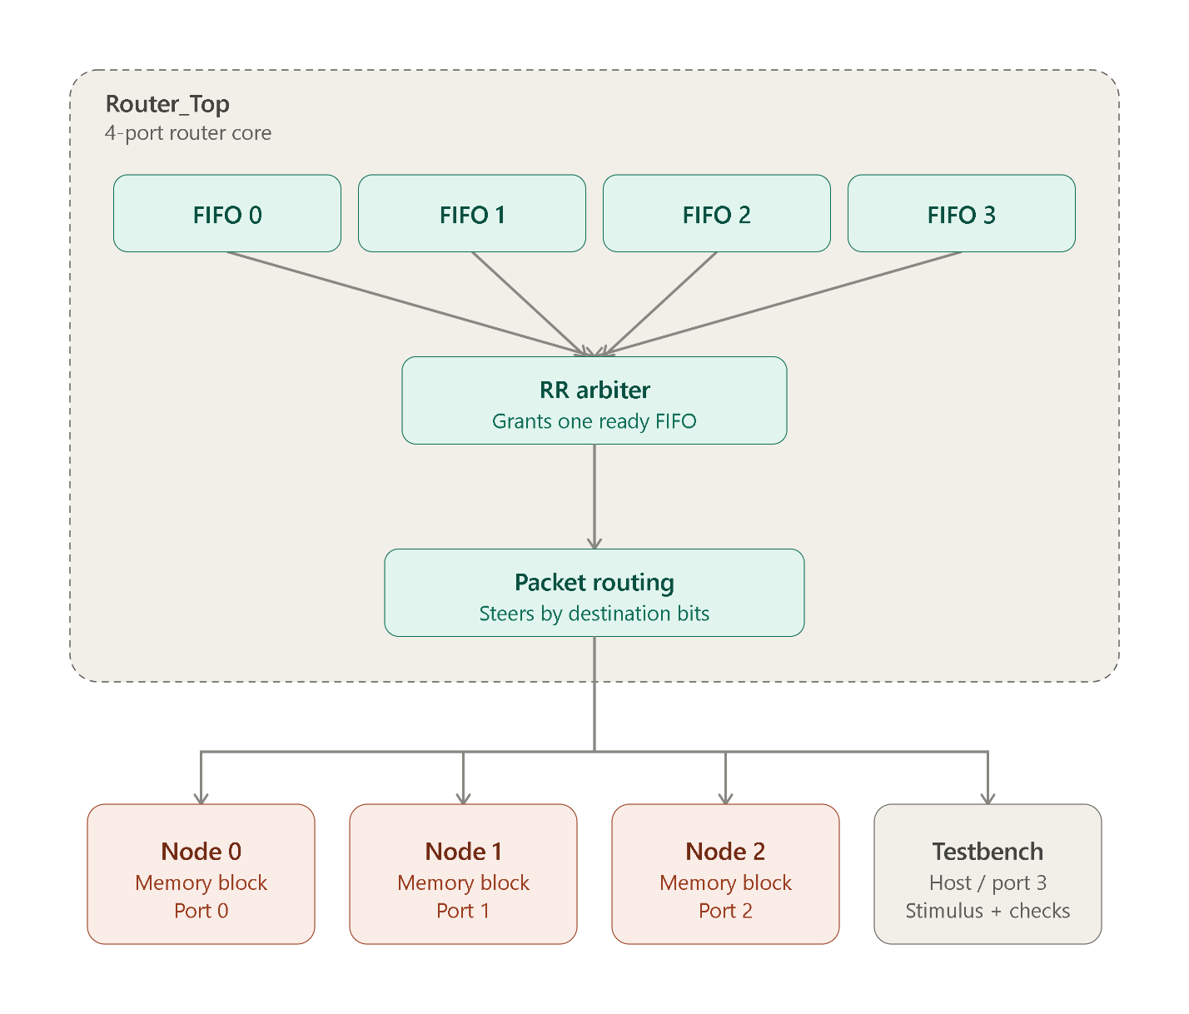
System Architecture
Packet Routing System · Digital IC Design Using FPGA
3 / 8

Slide 4
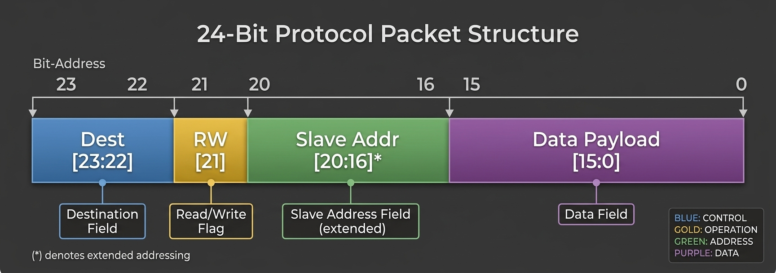
Packet Structure
Packet Routing System · Digital IC Design Using FPGA
3 / 8

Slide 5
Key Design Modules
Synchronous FIFO
Packet Routing
FIFO_Memory.v · Generic WIDTH×DEPTH buffer with empty/full flags
Packet_Routing.v · Decodes destination bits, steers to output ports
Four FIFO Buffers
Router Top
Four_FIFO_Buffers.v · Four independent 40-bit / 16-deep FIFOs
Router_TopModule.v · Top-level: Arbiter system + Packet Routing
Round-Robin Arbiter
Memory Node
RR_Arbiter.v · State-machine grants access in rotating order
ram.v · RAM slave: write / read + response packet
FIFO + Arbiter
Network System
FIFO_Arbiter_System.v · Integrates buffers with arbiter & mux
network.v · Router + 3 memory nodes + TB port
Packet Routing System · Digital IC Design Using FPGA
4 / 8

Slide 6
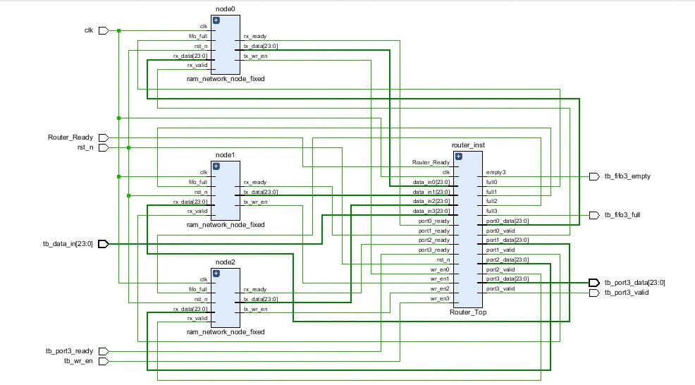
Network System Topology
Packet Routing System · Digital IC Design Using FPGA
5 / 8

Slide 7
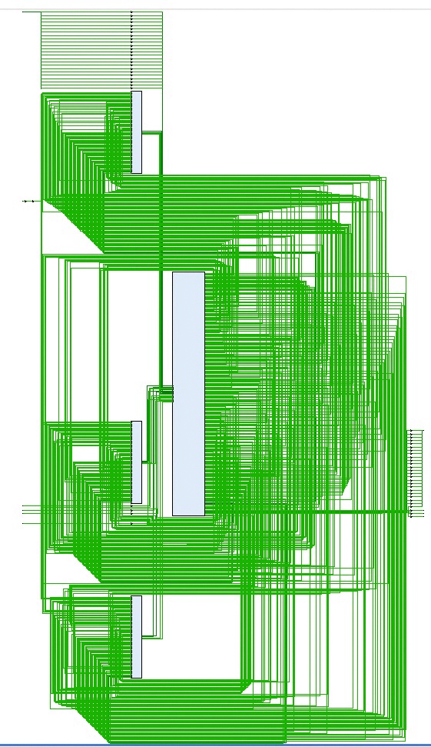
RTL Schematic (Post-Synthesis)
Packet Routing System · Digital IC Design Using FPGA
6 / 8

Slide 8
Simulation & Synthesis Results
Simulation Highlights
Resource Utilization
Write packets sent to Nodes 0, 1, 2
Read requests issued from Port 3
Responses verified on Port 3
All read-back data matched expected values
Round-robin fairness observed in waveforms
Resource | Used | Available | %
LUT | 868 | 303,600 | 0.29%
LUTRAM | 64 | 130,800 | 0.05%
FF | 1,859 | 607,200 | 0.31%
IO | 56 | 600 | 9.33%
Packet Routing System · Digital IC Design Using FPGA
7 / 8

Slide 9
Summary
Complete 4-port packet router designed and verified in Verilog
FIFO buffering + fair round-robin arbitration + destination routing
Closed network with three memory nodes and open testbench port
Simulation confirms correct write/read transactions
Synthesized successfully with very low resource usage

